Slide 2
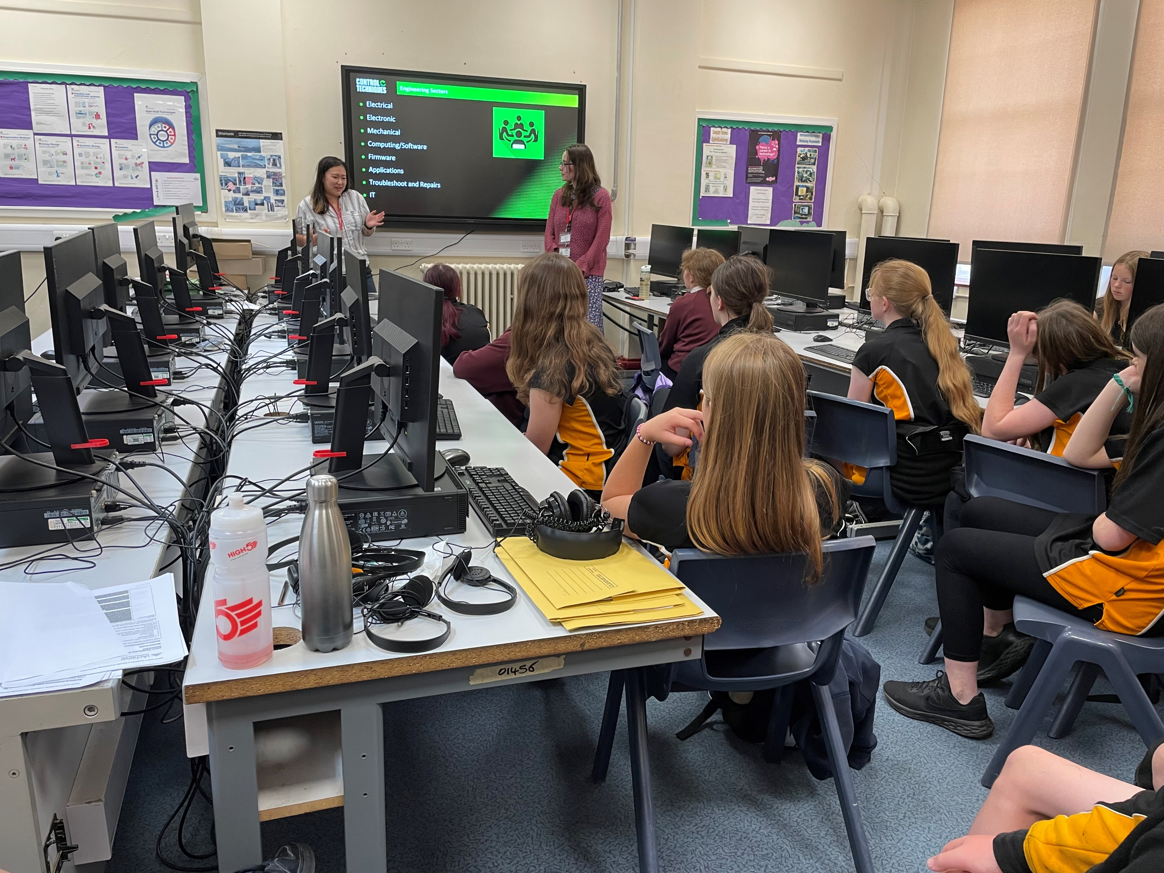

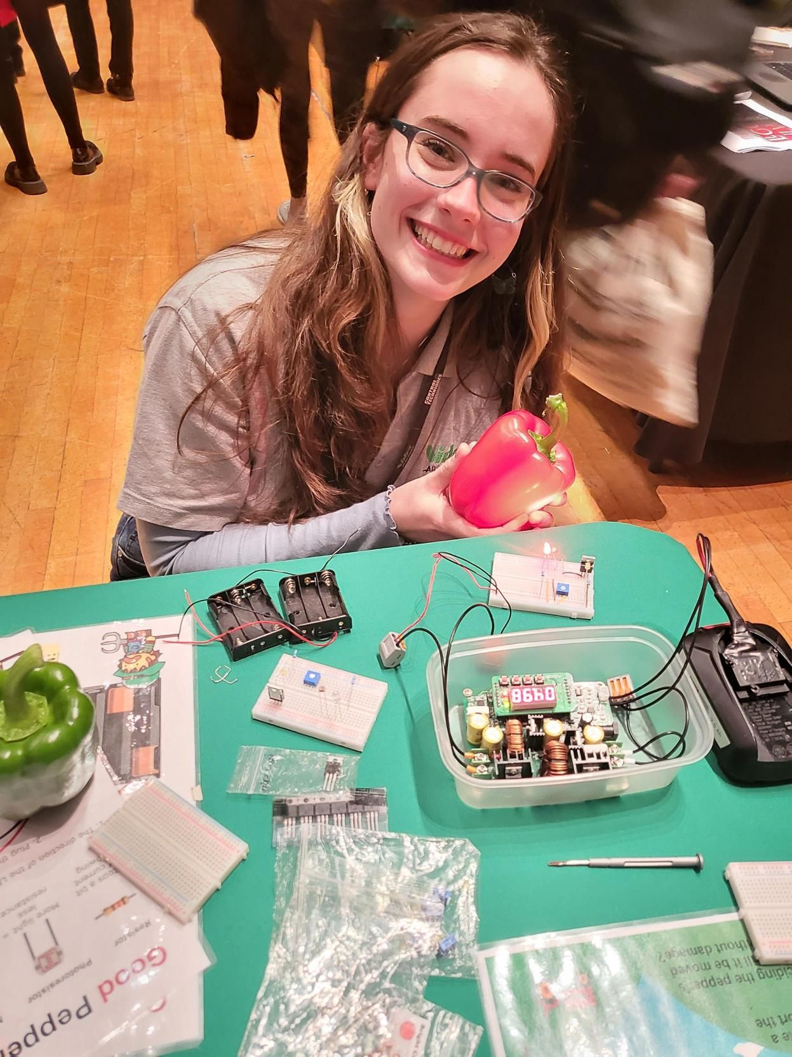
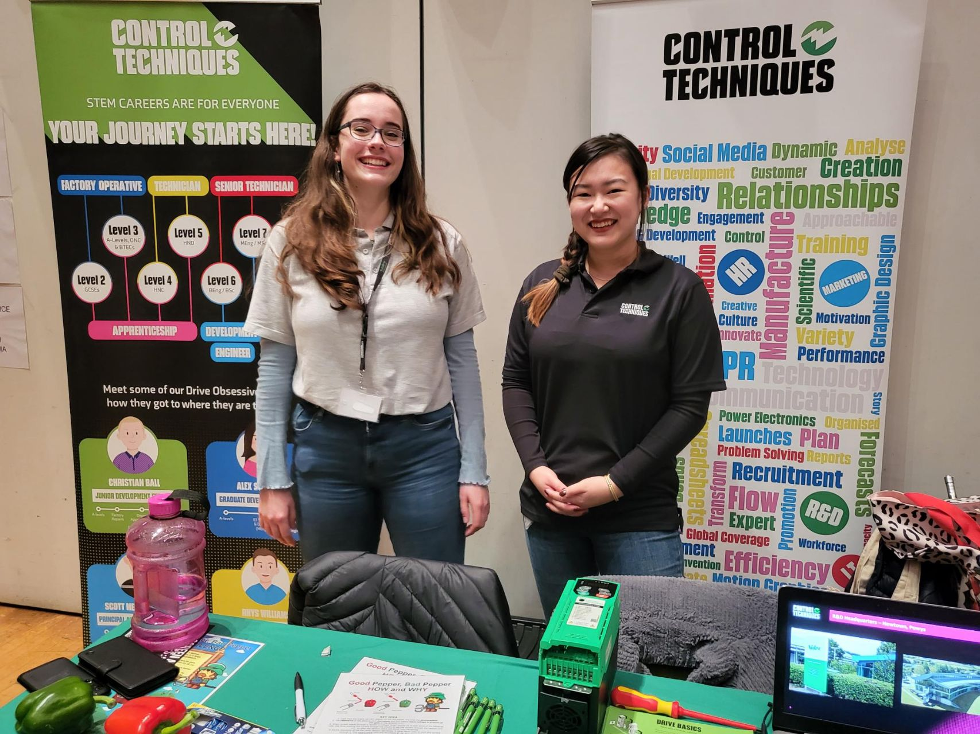
Previous Events
Careers Fair- Ceredigion Choose Your Future
Careers talk at Llanidloes High School
International Women’s Day Questions
Letter Writing
WES

Slide 3
Future Events
Cyber First – Careers Wales
STEM Careers (Shrewsbury) – STEM Ambassador
https://www.stem.org.uk/platform/activity/8d3da8df-bf59-4fa9-9bcc-103e5bcbbfc3
The Access Project
Supporting disadvantaged young women (aged 14-18) through GCSE tutoring
https://www.theaccessproject.org.uk/

